Slide 1
IceCream Shop
Made by Atanas Valchanov 9v

Slide 2
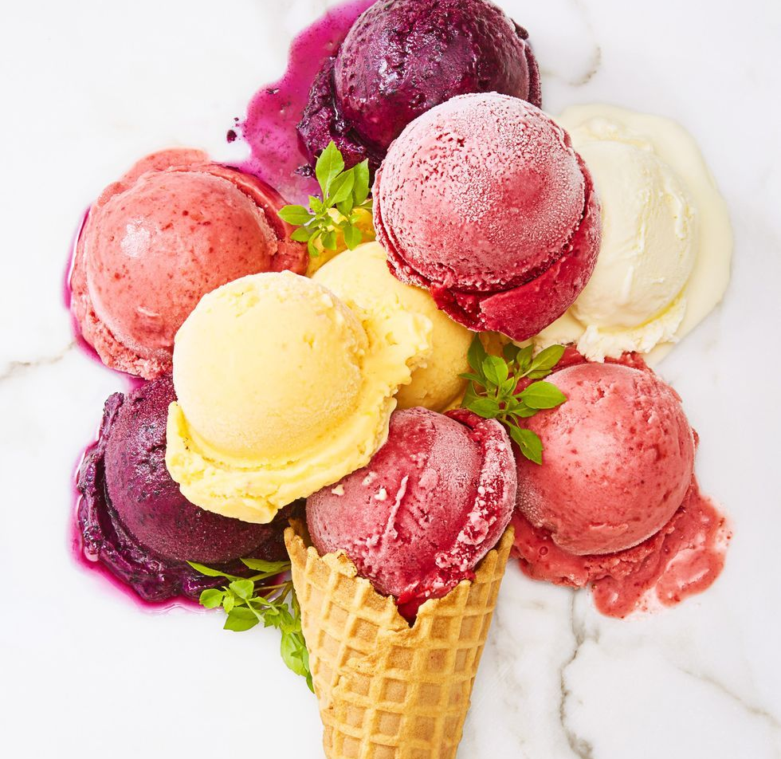
About the Project
I wanted to create a program which helps Ice Cream shop owners with orders. To do that I used C++ and some functions within it. The things you can do are simple:
Add kinds of Ice Cream to the menu.
Edit information about them.
Remove them from the menu.
And show all available Ice Cream at the moment

Slide 3

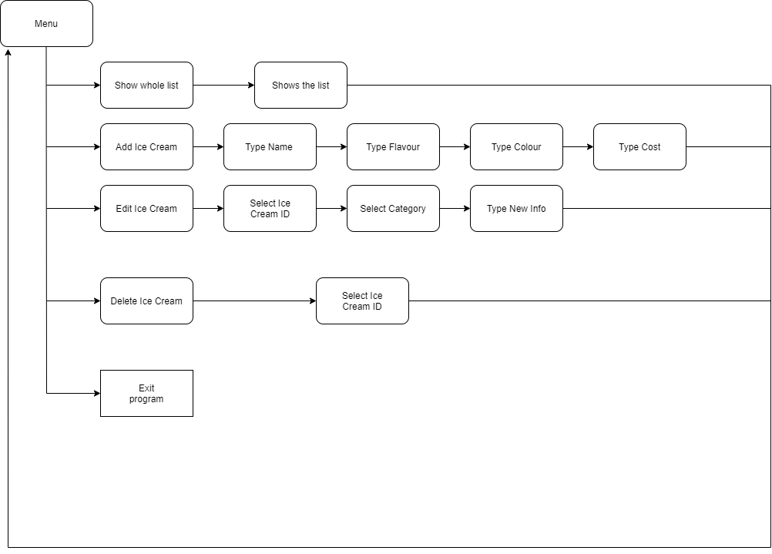
The logical scheme of my Program
This is the scheme of my program. It shows step by step how the how program works.

Slide 4

Possible Future Improvements
Translate the Program into many different languages
Make the Program look cleaner.
Add more details in the Create Ice Cream option.

